Slide 1
Lecture 20: Equilibrium in the Short Run
Outline
Short Run Aggregate Supply
Long run aggregate supply
Macro equilibrium with inflation
Shocks and gaps
Required Reading
Ch 21: selections
Notes:
As we’ll see, the Keynesian model is largely a model of what we call aggregate demand: (changes in) people buying stuff. Much of today’s effort goes into building that AD curve, the bulk of which is consumer purchases.

Slide 2
Short Run Aggregate Supply
Last class, we derived the Aggregate Demand curve and its shifters
AD comes from Aggregate Expenditure, just like the IS curve
Shifted by all the same things: C, I, and NX
Shifted by fiscal and monetary policy.
With a curve called aggregate demand, one called aggregate supply must be right around the corner!
In fact, we have a few types of aggregate supply curves
Short Run Aggregate Supply (SRAS)
Long Run Aggregate Supply (LRAS)

Slide 3
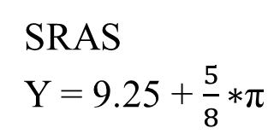
Short Run Aggregate Supply
Inflation rate,
π
Aggregate supply represents the relationship between inflation and output, from the perspective of producers
The short run aggregate supply curve (SRAS) represents that relationship when supply-side market imperfections exist
An inability to completely adjust to changes in market conditions
SRAS
7%
SRAS
Y = 9.25 + $\frac{5}{8}\text{∗}\text{π}$
2%
$10.5
$13.25
Output, Y
Notes:
This equation is, of course, just an example of what an SRAS curve might look like. Other supply curves can and do exist.

Slide 4
Short Run Aggregate Supply
As a supply curve, it slopes up.
As output rises, it puts greater demand on resources. We ask more of the resources we have, and it becomes harder to find unused inputs
Inputs are valued more, and so the cost of using them rises.
More people wanting more things means there is a greater excess demand for goods and services.
For both reasons, as output rises, firms will raise prices.
Vice versa, as output falls there is less demand for inputs and goods and services.
Firms have less desire or margin to raise prices

Slide 5
Short Run Aggregate Supply
The textbook Ch 21 graphs Y vs P. We will ALWAYS plot Y vs π.
Y vs π is more consistent with the MP-based derivation of AD.
Y vs π is more consistent with coming lessons (the “Philips Curve”)
Y vs π is a better description of reality
In Y vs P, it says “if output falls a little, P falls a little”. A deflation! A big (and rare) deal
Whereas Y vs π says “if output falls a little, inflation falls a little.”
A slowdown of the rate of change. Very common, much more plausible.
Just a matter of interpretation. When the textbook plots P on the vertical of AD vs SRAS, think “they mean the rate of change of P”

Slide 6
Short Run Aggregate Supply
Firms produce in order to make a profit.
Profit per unit = price – cost per unit
Changes in price cause slides along the SRAS curve.
Changes in production costs change willingness to produce at a given price.
For a given rate of inflation, SRAS will shift as…
Input prices rise or fall.
Higher input prices means higher production cost, means less profit. Less willingness to produce
Production technology changes
Better technology means same production at lower cost. Higher profit

Slide 7
Short Run Aggregate Supply
SRAS shifters
Changes in the exchange rate
A weaker dollar means inputs bought from foreigners will be more expensive. Higher costs means less profit.
In the IS-MP lecture, we made an assumption about the relationship between prices and output
We assumed that inflation was constant, and yet output would change in response to demand shifts
The so-called “sticky price” assumption

Slide 8
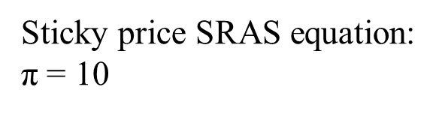
Short Run Aggregate Supply
That is a statement of elasticity: the sensitivity of one variable with respect to changes in another.
“Sticky prices” assumes that the output is perfectly sensitive to inflation: output can adjust a lot in response to no change in inflation
That is one extreme version of SRAS: the sticky price SRAS
π
Sticky price SRAS equation:
$\text{π}$ = 10
10%
sticky-price
SRAS
Y
Notes:
Elasticity is something that you learned in Econ 101, if you’ve taken 101. Which you should have. If not, we won’t belabor the mechanics of that calculation here.

Slide 9
Short Run Aggregate Supply
That’s one extreme – output is perfectly flexible and inflation is perfectly inflexible
We used that assumption in IS-MP.
Whenever we draw IS-MP we are ASSUMING a sticky-price SRAS
In most circumstances, we assume that firms need an incentive to raise their output
Rising demand for inputs or outputs creates room to raise prices.
Higher prices, given costs, means higher profit per unit
Another statement of elasticity! Usually, changes in output are associated with changes in inflation

Slide 10
Short Run Aggregate Supply
In most circumstances, when we model AD and AS…
SRAS has a positive slope
There is a market imperfection:
our short run model is a model of inefficiency, when the capacity of the economy to produce differs from its actual level of output.
That degree of imperfection (the “friction”; the “stickiness”) is reflected in our AS curve, through its elasticity
The upward slope represents the responsiveness of output to changes in inflation.
The FLATTER the AS curve, the more output changes with inflation
The STEEPER the AS curve, the less output changes with inflation
Notes:
“output changing with inflation” is an indication of the market imperfections. As we’ll see, a PERFECT market would simply produce according to the available inputs. Output would have NO relationship to inflation. Output would be fixed. The more output wobbles, the more imperfect the markets. The wobbles are what countercyclical policy tries to fix!

Slide 11
Short Run Aggregate Supply
The sticky price SRAS can’t adjust pricing at all; only output adjusts to demand
The “very short run”: firms don’t have enough time to re-negotiate prices or costs
With more time, firms can…
Adjust prices they charge in response to changes in costs
Re-negotiate the price of SOME of their inputs
π
10%
sticky-price
SRAS
Y

Slide 12
Short Run Aggregate Supply
This SRAS represents more ability to adjust prices in response to excess demand for output (Y).
But it’s not a perfect ability!
Some costs can be adjusted and others not.
Sometimes called a “sticky wage” SRAS: the SRAS when the firm can adjust the price of their good, but NOT the cost of labor
π
sticky-wage
SRAS
10%
sticky-price
SRAS
Y

Slide 13
Short Run Aggregate Supply
“Medium run” SRAS
The more time passes…
more goods and input prices can be re-negotiated
More input usage can be adjusted
More economic choices can be adjusted in response to the current economic context
The “medium run” curve here represents flexible wages but fixed capital utilization
π
sticky-wage
SRAS
10%
sticky-price
SRAS
Y
Notes:
Remember your Econ 101! The long run is, by definition, the time horizon over which ALL inputs are variable. All contracts can be re-negotiated. All issues of scale can be optimized to their lowest-cost level.

Slide 14

Long Run Aggregate Supply
“Medium run” SRAS
At the other extreme is a situation where all prices and contracts and input usage can be freely adjusted.
When all prices can adjust, the market clears.
When input markets clear, all available resources are used
Given a production function, inputs determine output
π
sticky-wage
SRAS
10%
sticky-price
SRAS
$$\overline{Y}$$
Y

Slide 15
Long Run Aggregate Supply
Long Run
Aggregate Supply
The Long Run Aggregate Supply Curve (LRAS) is the relationship between inflation and output, from the perspective of producers, when ALL prices are flexible
Long run output is determined by resources, and prices can be whatever they need to be for the market to clear
A “perfect” market
π
$$\overline{Y}$$
Y

Slide 16
Long Run Aggregate Supply
This is the same long run as in Econ 101; as in classical economics
All inputs are flexible/variable
All prices can change
All resources will be used at their efficient levels
This is the same long run as in Solow Growth
Take inputs as given – if they are available, they are used
Prices “don’t matter” – prices can and will be whatever they must, in order to assure that all markets clear.
The long run and the (sticky price) short run are two extremes of the same spectrum, depending on how flexible prices are

Slide 17
Long Run Aggregate Supply
If prices were always perfectly flexible, we’d always be in the long run
If we were always in the long run, we wouldn’t have a business cycle!
We have a business cycle because markets are NOT always perfect
Markets are not perfect because they contain frictions and imperfections like price stickiness; that’s the Keynesian insight
The extent to which we’re going through a boom and bust cycle is the extent to which output differs from the long run
The goal of countercyclical policy is to keep us in the long run

Slide 18
Long Run Aggregate Supply
We saw a version of this in the unemployment section
Unemployment U had three components: structural, frictional, and cyclical. U = SU + FU + CU
When output is not influenced by the business cycle, cyclical unemployment CU = 0.
That’s the long run!
In the long run, total U = structural U + frictional U
Sometimes we call that “the natural rate of unemployment”
NU = SU + FU
In the long run, inputs are used at their “natural” (or sometimes called “neutral”) rates of utilization

Slide 19
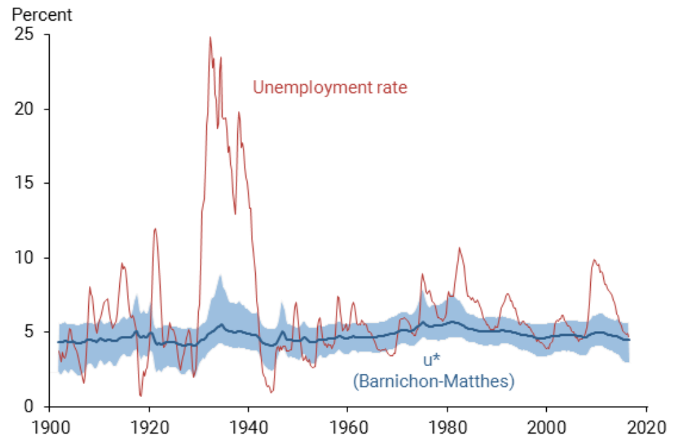
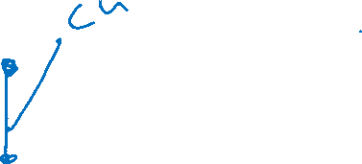
Long Run Aggregate Supply
Natural rate of unemployment
Notes:
Natural rate estimates from the federal reserve bank: https://www.frbsf.org/economic-research/publications/economic-letter/2017/august/natural-rate-of-unemployment-over-past-100-years/
The blue shaded area is a 90% confidence interval – it’s a measure of statistical uncertainty. Since we don’t SEE the natural rate, we need to estimate it. The “real” rate is somewhere in the blue area. So, when the red U leaves the blue shaded area, we are very confidence that actual U is different from the natural rate.

Slide 20
Macro equilibrium with inflation
Now we’re ready for equilibrium!
Here we’re jointly modeling output Y and inflation π
In MICRO supply and demand, we model relative prices
By definition of “relative”, as one price rises, another relatively falls
In MACRO aggregate supply and demand, we model the phenomenon of all prices rising and falling together: inflation
Micro S&D can not explain this! It’s a totally separate phenomenon, using a totally separate model
First fact of macro equilibrium: AD and SRAS always determine the current output and inflation

Slide 21
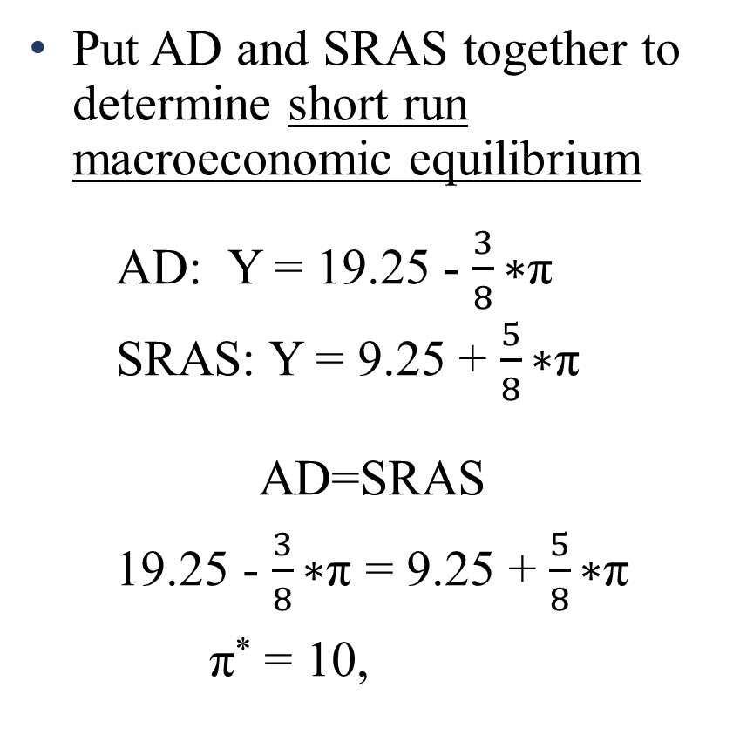
Macro equilibrium with inflation
Put AD and SRAS together to determine short run macroeconomic equilibrium
AD: Y = 19.25 - $\frac{3}{8}\text{∗}\text{π}$
SRAS: Y = 9.25 + $\frac{5}{8}\text{∗}\text{π}$
AD=SRAS
19.25 - $\frac{3}{8}\text{∗}\text{π}$ = 9.25 + $\frac{5}{8}\text{∗}\text{π}$
$\text{π}$* = 10, .
π
SRAS
10%
AD
Y* = 15.5
$15.5
Y
Notes:
Of course, since this SRAS is up-sloping, it must be a “medium-run” curve where some input prices are stuck and others are not.

Slide 22
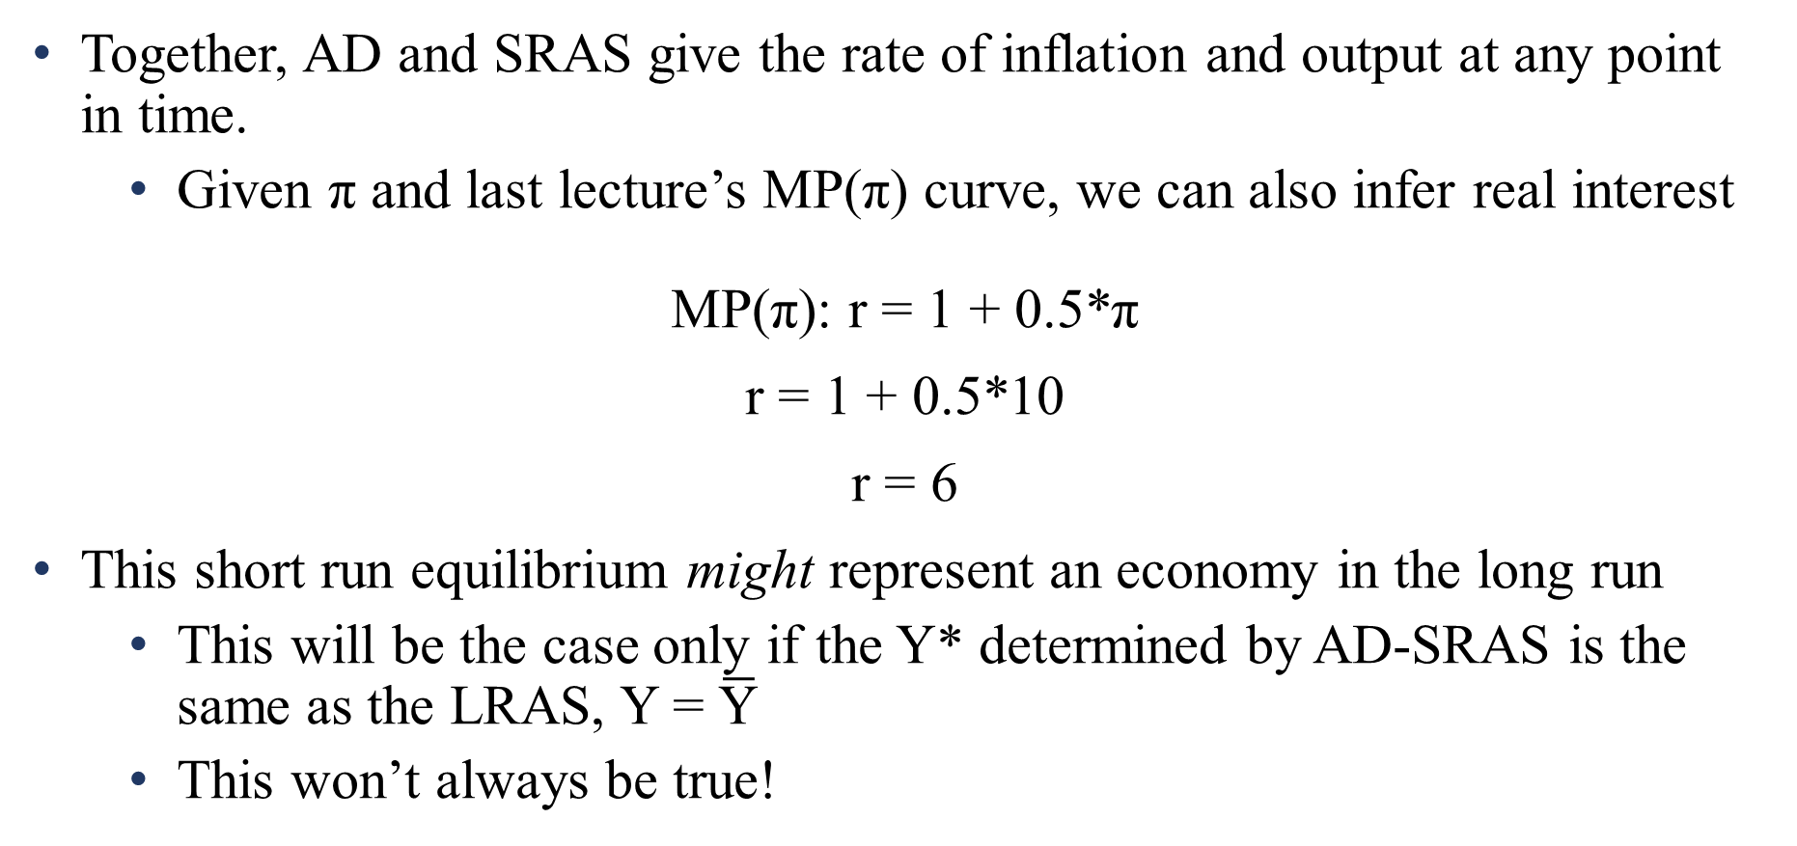
Macro equilibrium with inflation
Together, AD and SRAS give the rate of inflation and output at any point in time.
Given $\text{π}$ and last lecture’s MP($\text{π}$) curve, we can also infer real interest
MP(π): r = 1 + 0.5*π
r = 1 + 0.5*10
r = 6
This short run equilibrium might represent an economy in the long run
This will be the case only if the Y* determined by AD-SRAS is the same as the LRAS, Y = $\overline{\text{Y}}$
This won’t always be true!

Slide 23


Macro equilibrium with inflation
In this example, if the level of output when we use our resources at their natural rates is $15.5, then the economy is in its long run macroeconomic equilibrium
Short run conditions happen to put us in the long run
The long run always occurs where AD = LRAS
π
LRAS
SRAS
10%
AD
$$\overline{Y}=$$
$15.5
Y

Slide 24
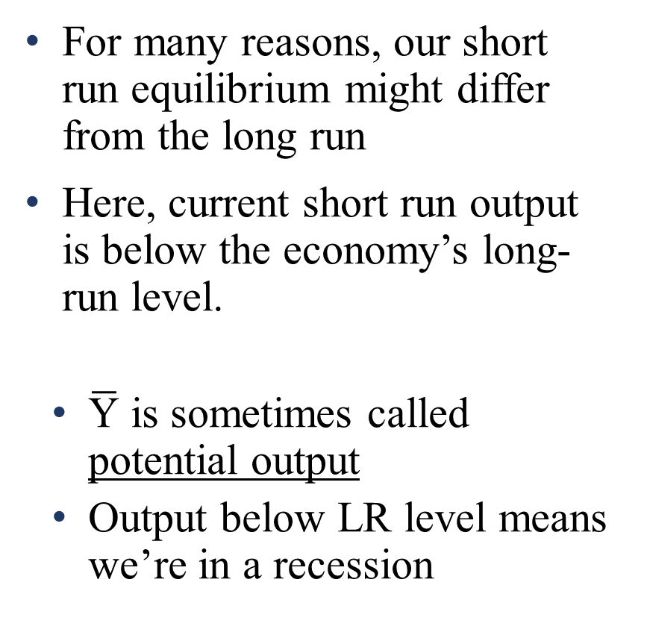


Macro equilibrium with inflation
π
LRAS
For many reasons, our short run equilibrium might differ from the long run
Here, current short run output is below the economy’s long-run level.
$\overline{\text{Y}}$ is sometimes called potential output
Output below LR level means we’re in a recession
SRAS
10%
AD
$15.5
$\overline{Y}$ = $18
Y

Slide 25
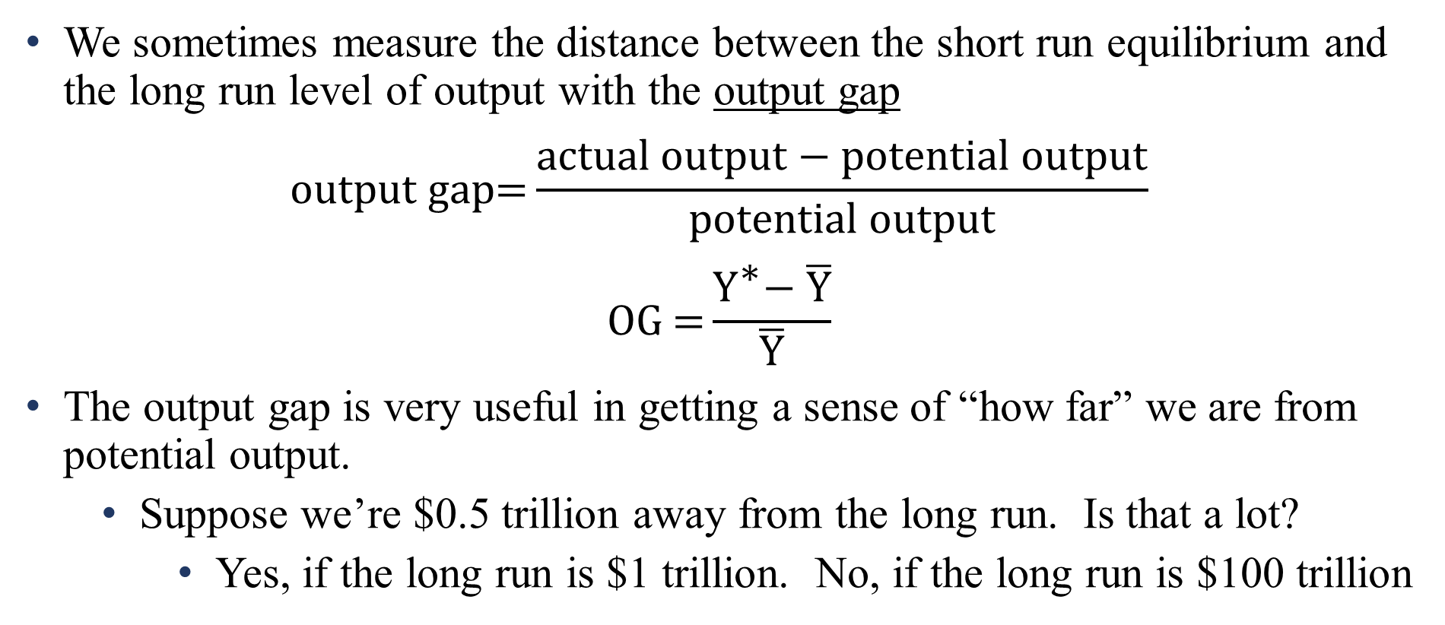
Macro equilibrium with inflation
We sometimes measure the distance between the short run equilibrium and the long run level of output with the output gap
$$o\text{utput} \text{gap}\text{=}\frac{\text{actual} \text{output}\text{ − }\text{potential} \text{output}}{\text{potential} \text{output}}$$
$$\text{OG}\text{ =}\frac{{\text{Y}}^{\text{∗}}\text{− }\overline{\text{Y}}}{\overline{\text{Y}}}$$
The output gap is very useful in getting a sense of “how far” we are from potential output.
Suppose we’re $0.5 trillion away from the long run. Is that a lot?
Yes, if the long run is $1 trillion. No, if the long run is $100 trillion
Notes:
If you’re reading the textbook (and you should be!) you’re seeing the output gap a bunch – it is how the authors label their short run graphs. As with all models, that label has its strengths and its weaknesses.

Slide 26
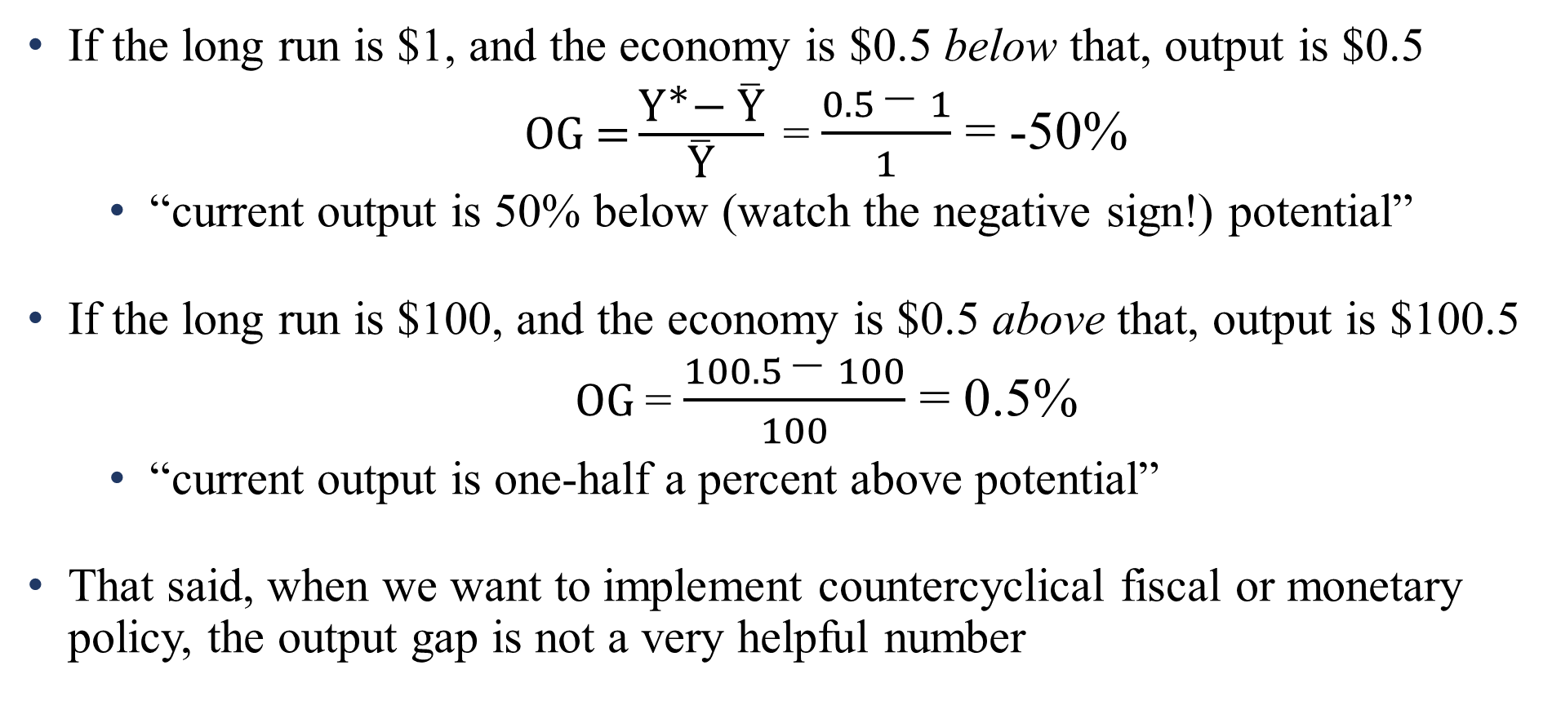
Macro equilibrium with inflation
If the long run is $1, and the economy is $0.5 below that, output is $0.5
$\text{OG}\text{ =}\frac{{\text{Y}}^{\text{∗}}\text{− }\overline{\text{Y}}}{\overline{\text{Y}}}$= $\frac{0.5 \text{− }1}{1}$ = -50%
“current output is 50% below (watch the negative sign!) potential”
If the long run is $100, and the economy is $0.5 above that, output is $100.5
$\text{OG}$= $\frac{100.5 \text{− }100}{100}$ = 0.5%
“current output is one-half a percent above potential”
That said, when we want to implement countercyclical fiscal or monetary policy, the output gap is not a very helpful number

Slide 27
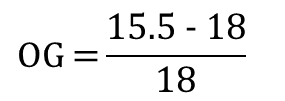
Macro equilibrium with inflation
π
LRAS
“The output gap is -14%. How much more spending do we need to close the gap”?
If LR output is $100, need $14 of total new spending.
If LR output is $100,000,000,000, need $14,000,000,000!
As a result, I prefer to plot Y on the horizontal, rather than the output gap. That’s the policy-relevant quantity
$$\text{OG}\text{ =}\frac{15.5\text{ −} 18}{18}$$
SRAS
≈ - 14%
10%
AD
$15.5
$\overline{Y}$ = $18
Y
Notes:
Note to self: that’s 100 billion, dummy
Another reason to prefer Y on the horizontal: it’s literally what we’re modeling! AS is a statement of total output. The IS curve models Y as it relates to r. AD models Y as it relates to pi. They all explain Y! Switching variables to the output gap is fine – it’s just one more step in the chain of logic – but in many cases, in my opinion, is obscures what we’re modeling, and what we care about.

Slide 28
Shocks and gaps
We’re ready to ask that big question of macroeconomics: where do business cycles come from?
That’s the same as asking “why do output gaps arise”?
(plus a follow-up question: “why do output gaps go away?”)
The mechanical answer is: something pushes the short-run equilibrium away from the long run equilibrium
We’ve got two curves that can move: AD and SRAS
We’ve got two types of output gaps: positive and negative.
So, we’ve got four ways to kick off a business cycle

Slide 29


Shocks and gaps
inflation (π)
inflation (π)
LRAS
LRAS
SRAS
SRAS
π falls
π rises
AD₁
AD₂
Y falls
AD₂
Y rises
AD₁
Y*
$$\overline{Y}$$
output (Y)
$$\overline{Y}$$
Y*
output (Y)
negative AD shock: “recessionary gap”
positive AD shock: “inflationary gap”
Notes:
These are illustrations of the fundamental Keynesian theory, the one presented in earlier lectures, that the business cycle reflects DEMAND side fluctuations

Slide 30
Shocks and gaps
inflation (π)
inflation (π)
LRAS
LRAS
SRAS₂
SRAS₁
SRAS₁
π rises
SRAS₂
AD
π falls
Y falls
Y rises
AD
Y*
$$\overline{Y}$$
output (Y)
$$\overline{Y}$$
Y*
output (Y)
negative SRAS shock: “stagflation”
positive SRAS shock: “expansionary gap”
Notes:
These types of recessions are real challenges to the assertion that “the business cycle happens because of demand shocks”! That statement, taken to its extreme, is simply not true.
That said, AD-driven shocks are empirically much more common. Anything resembling a “financial crisis” is always an AD shock. The classic SRAS shock is the OPEC oil embargo of the mid-1970s, where input prices (oil / energy) spiked upwards.

Slide 31
Shocks and gaps
What is the source of the business cycle? Shocks! Shocks! Shocks!
Why do shocks arise?
Answer number one: ¯\_(ツ)_/¯
Answer number two: any of the shifters of any of the curves!
Answer 1 is a central insight!
Households and firms are forward looking. Expectations of the future (income, wealth, taxes, etc) are built into current spending choices.
The things that shift the curves are things that are fundamentally unpredictable. If it was a predicted change, it’s already part of AD!
Notes:
Shifters of the curves are what we’ve been talking about for the last three lectures. Supply-side shifters were today: changes in expected profitability: input costs and technology. Demand side shifters are shifters of the C(Y,r) function, shifters of the I(r) function, the G(r), and the NX(r) functions. Monetary policy, fiscal policy. IS-MP! AD! We’ve already done it all.

Slide 32
Next:
Countercyclical policy

